Slide 1
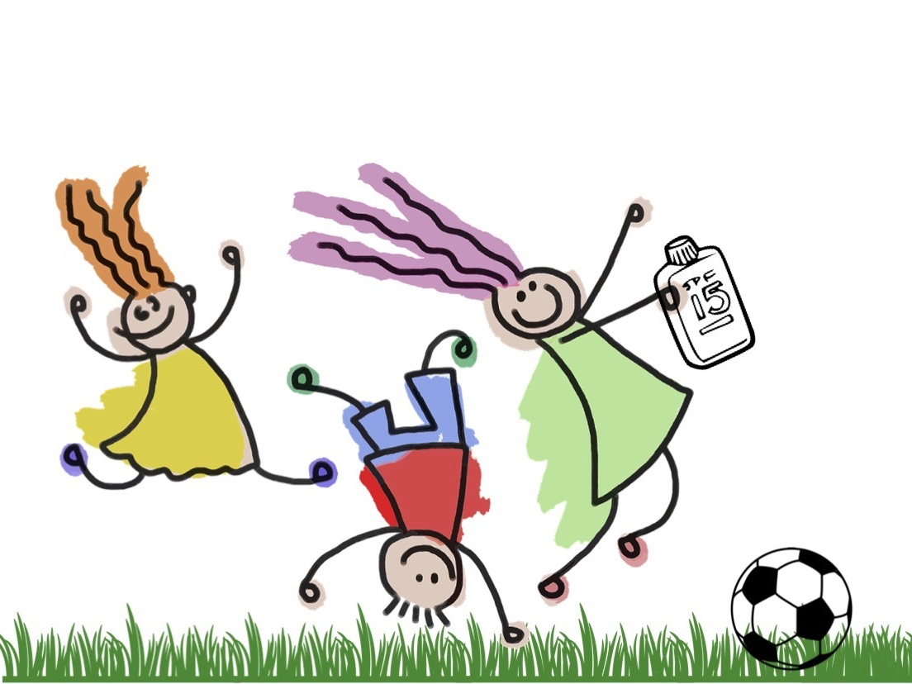

Staying Safe in the Sunshine
RJ125

Slide 2


Slide 3
Staying Safe in the Sunshine
RJ125

Slide 4
Outline
1
Xiuhua: Problem
2
Andy: Causes & Approach
3
Hannah: Solution 1 (SunProtectionNow!)
4
Zhizhi: Solution 2 (Sun Protection Support)
5
Zharfan: Evaluation & Conclusion

Slide 5

Lack of Sun Protection Habits
UV overexposure!
Sun protection (30%)
No sun protection
No sun protection

Slide 6
High UV Levels
Atmosphere
Incoming UV rays
--- Equator ---
Incoming UV rays
Shorter distance, smaller area
Incoming UV rays

Slide 7
High UV Levels
Extreme
Very high
UV Index

Slide 8
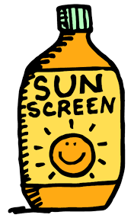


Outdoor Activities
= UV OVEREXPOSURE

Slide 9
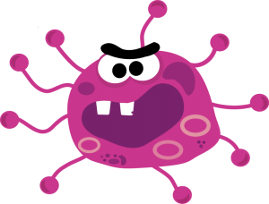
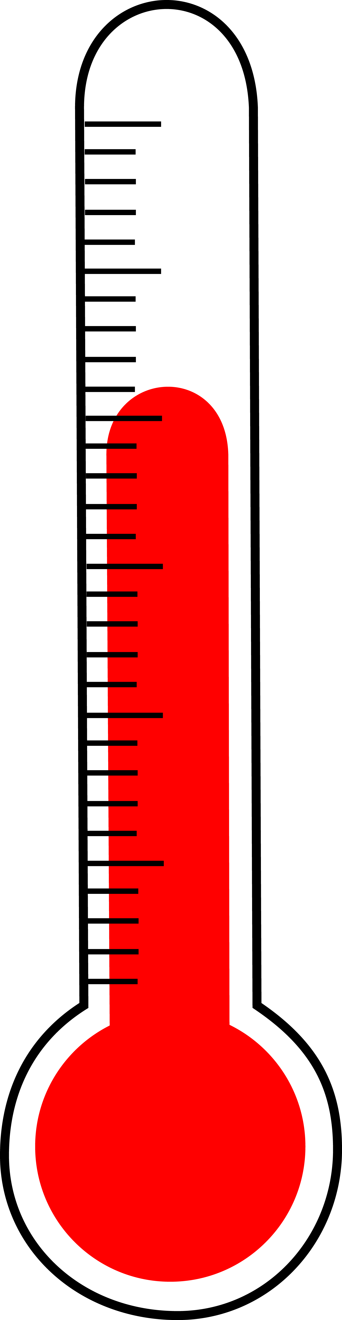
Effects of UV Overexposure
Premature skin aging
Immune suppression
Eye damage
Skin cancer

Slide 10
Skin Cancer

Slide 11
Skin Cancer
6th
7th

Slide 12
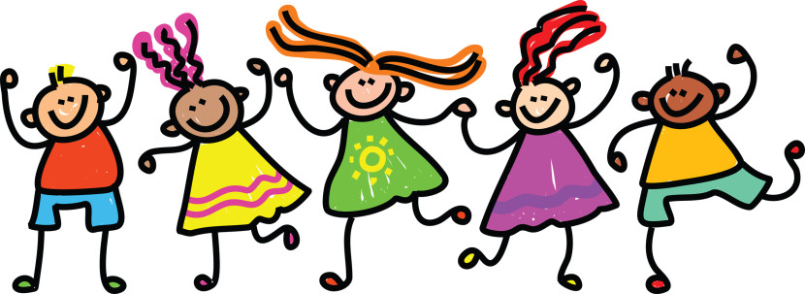
Target Group
Singaporean secondary school students

Slide 13
Causes & Approach

Slide 14
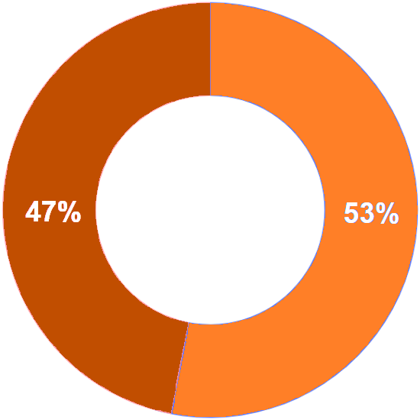
Apathy
Indicated
Did not indicate

Slide 15
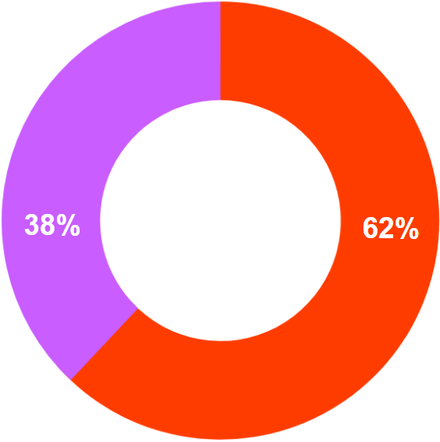

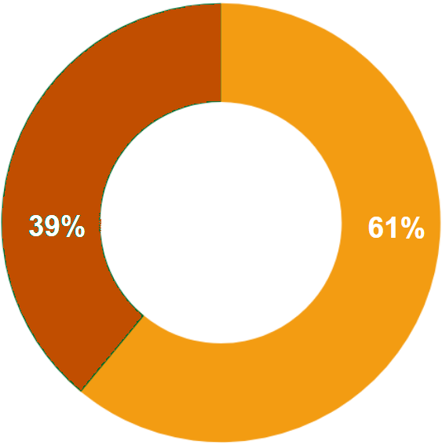
Concern
Awareness
"Skin cancer"
0-4
No "skin cancer"
5-10

Slide 16
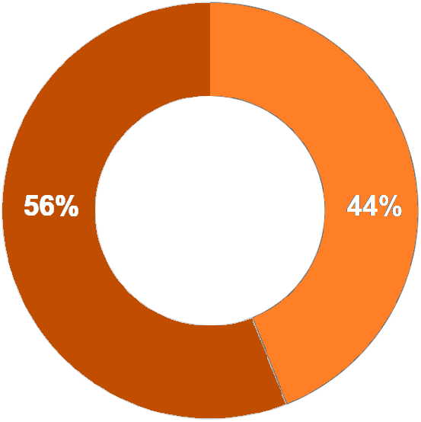
Lack of Convenient Access
Indicated
Did not indicate

Slide 17
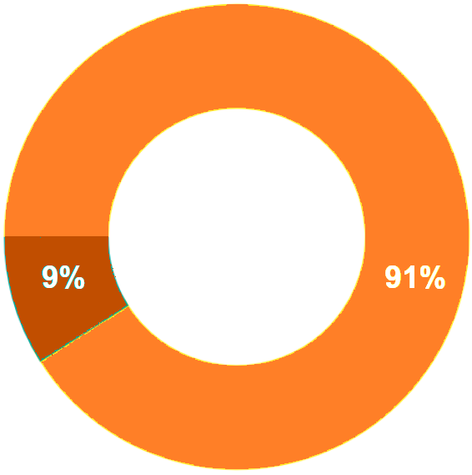
Significant Sun Exposure
No "PE"
"PE"

Slide 18
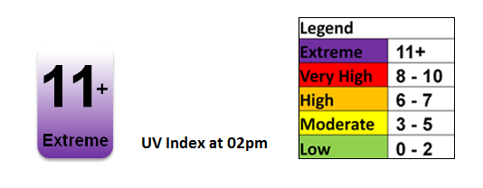
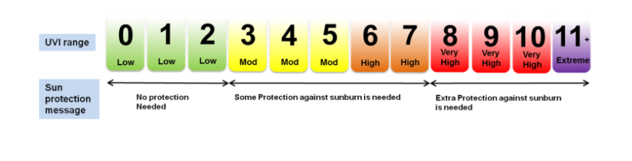
NEA UVI Updates
95%

Slide 19
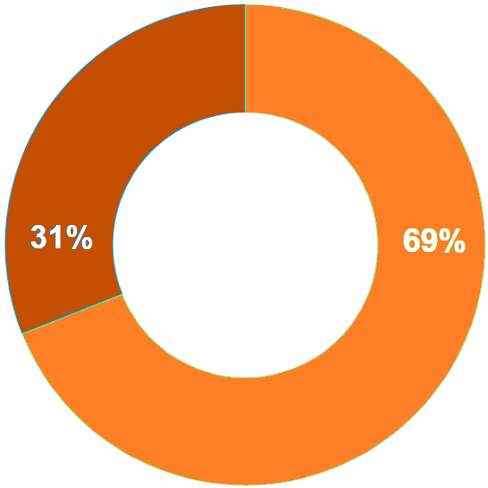
Lack of Reminders
Never
Others

Slide 20
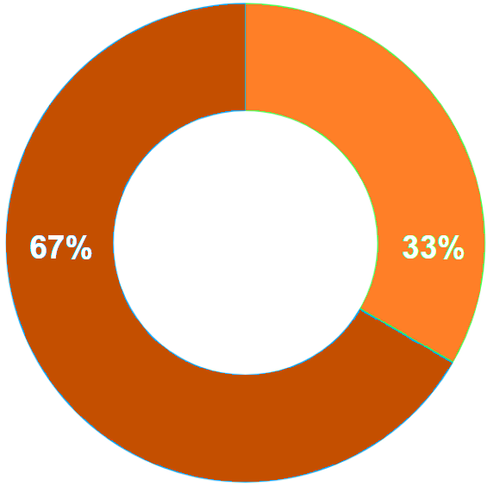
Forgetfulness
Indicated
Did not indicate

Slide 21

Dealing with the Problem
Apathy
Evocation of Fear
SunProtectionNow!

Slide 22
Dealing with the Problem
Lack of Reminders
Lack of Convenient Access
Convenient Access
Reminders
Sun Protection Support

Slide 23
SunProtectionNow!

Slide 24

Overview
SunProtectionNow!
Apathy
School-based Activity
Social Media Campaign

Slide 25
Aims
Social Media Campaign
Empathy
Fear

Slide 26




Social Media Campaign
5 Day-Long
Social Media Platforms
One Video
One Message

Slide 27
Aurora
An emotional story about a 15-year-old girl

Slide 28

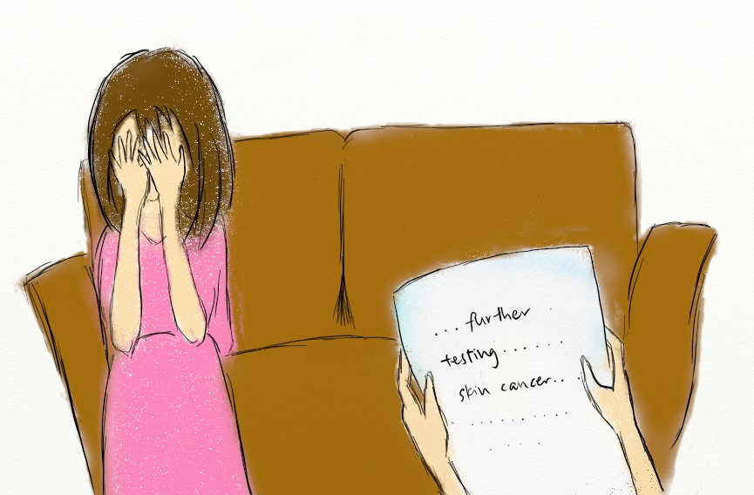
Episode I

Slide 29
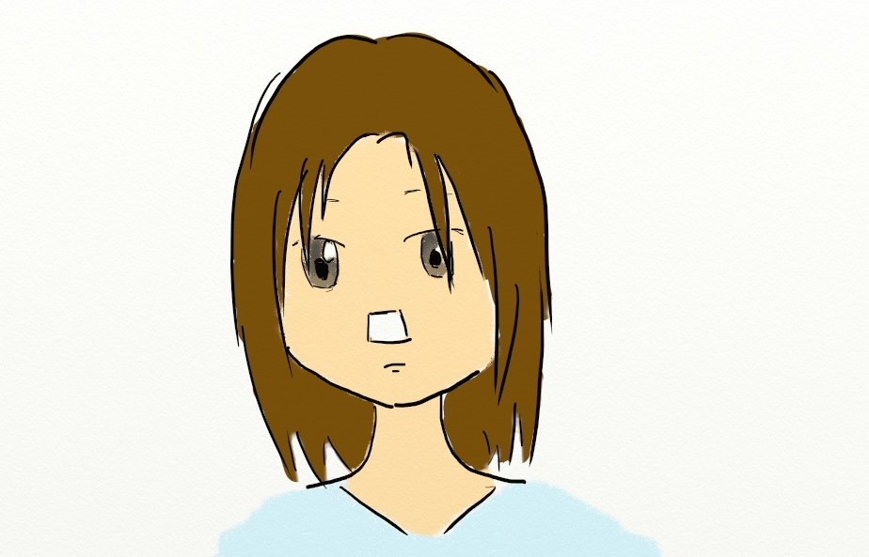
Episode II

Slide 30
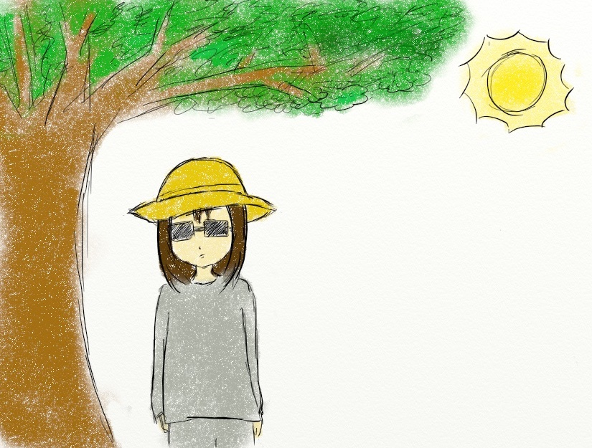
Episode III

Slide 31
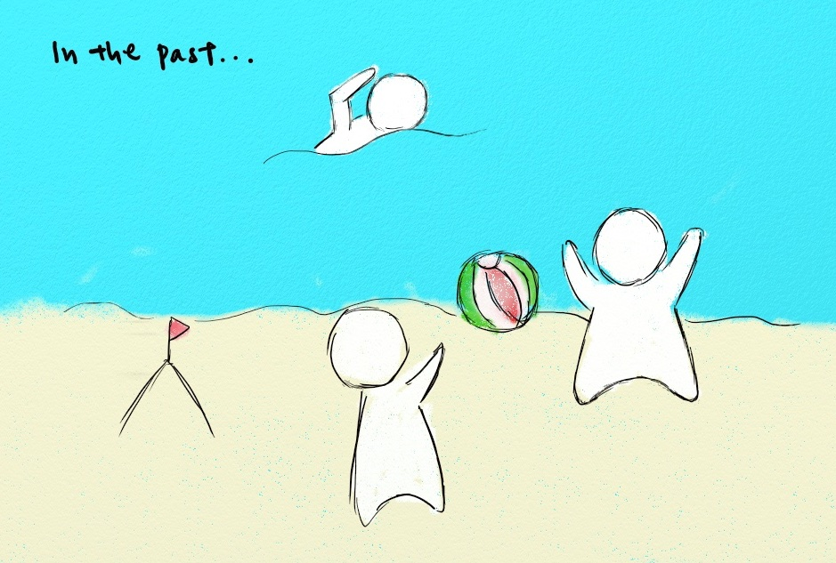
Episode IV

Slide 32
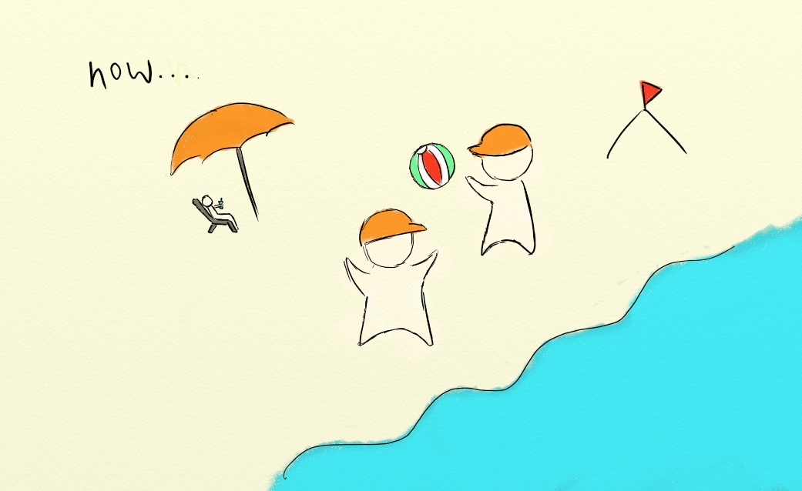
Episode V

Slide 33
Learning Points
One
Two
Skin cancer affects loved ones
Skin cancer is not trivial

Slide 34

UV Camera Photo Booth
Concurrent with Social Media Campaign
Canteen

Slide 35
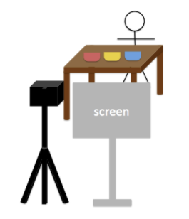
UV Camera Photo Booth
Coloured Sunscreen
UV camera connected to a projector

Slide 36
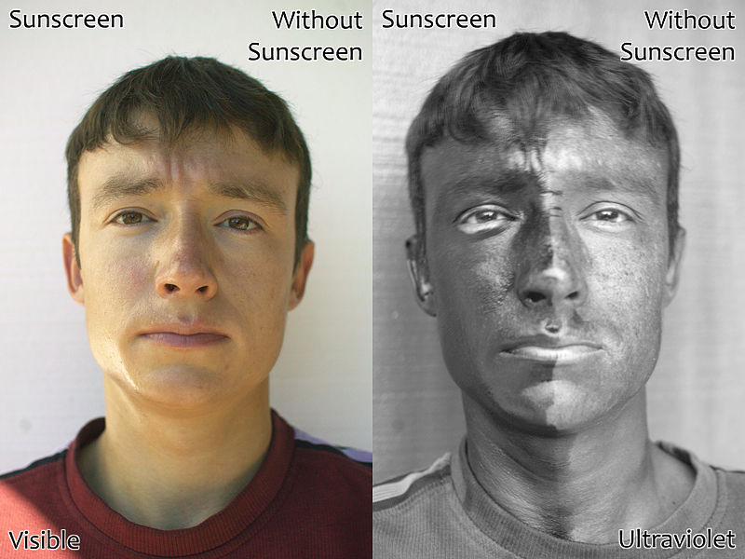
Contrast
Wrinkles
Blotches

Slide 37
Summary
63%
Emotions
Connection

Slide 38
Sun Protection Support

Slide 39

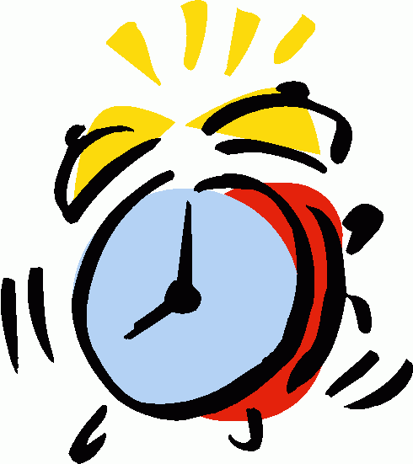
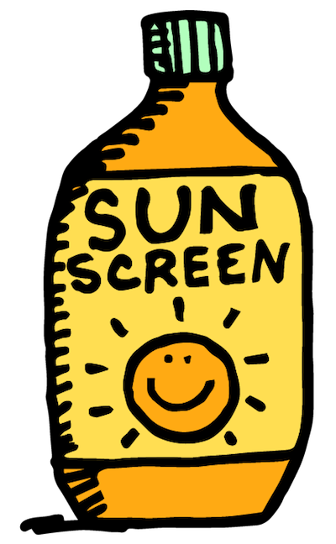

Overview
✔
✗
✗
UV Alert
Sunscreen vending machine

Slide 40
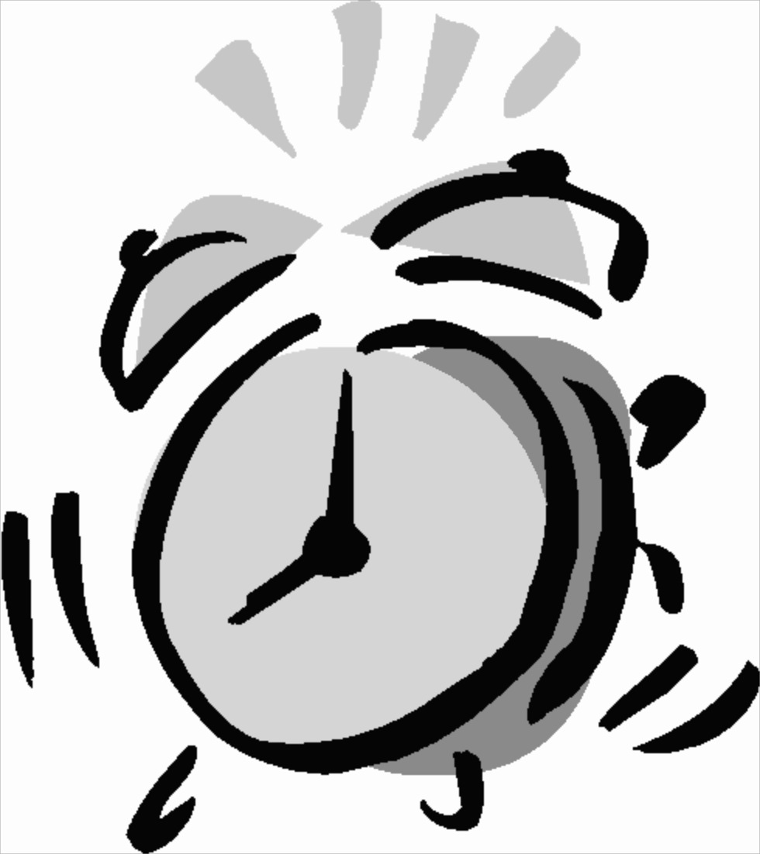
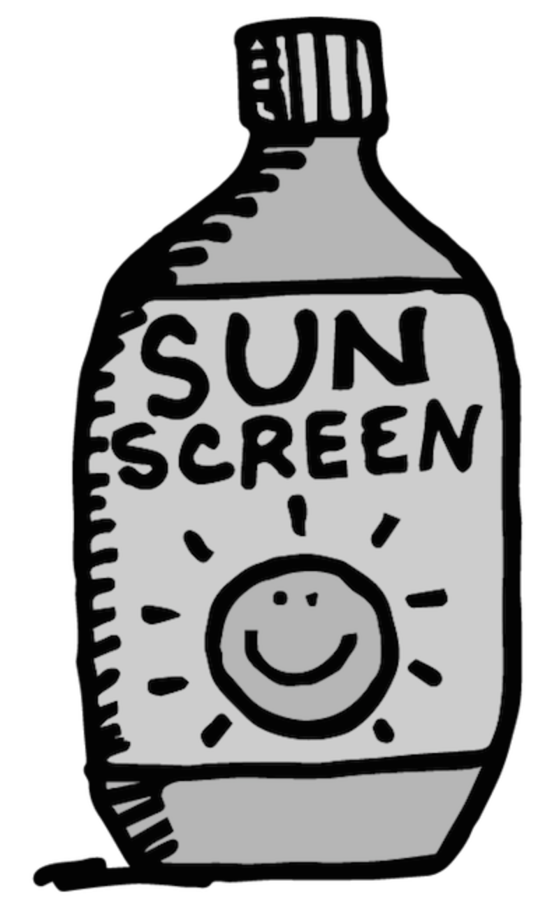
UV Alert
3 different coloured lights

Slide 41
UV Alert
UVI 0-2 (Low)
Safe to stay under the sun
No action required

Slide 42
UV Alert
UVI 3-7 (Moderate/moderately high)
Apply SPF30+ sunscreen every 2 hours
Wear protective clothing and wide-brimmed hat if possible

Slide 43
UV Alert
UVI 8-11 (High/Extreme)
Stay out of the sun as far as possible
Take multiple sun protection measures

Slide 44
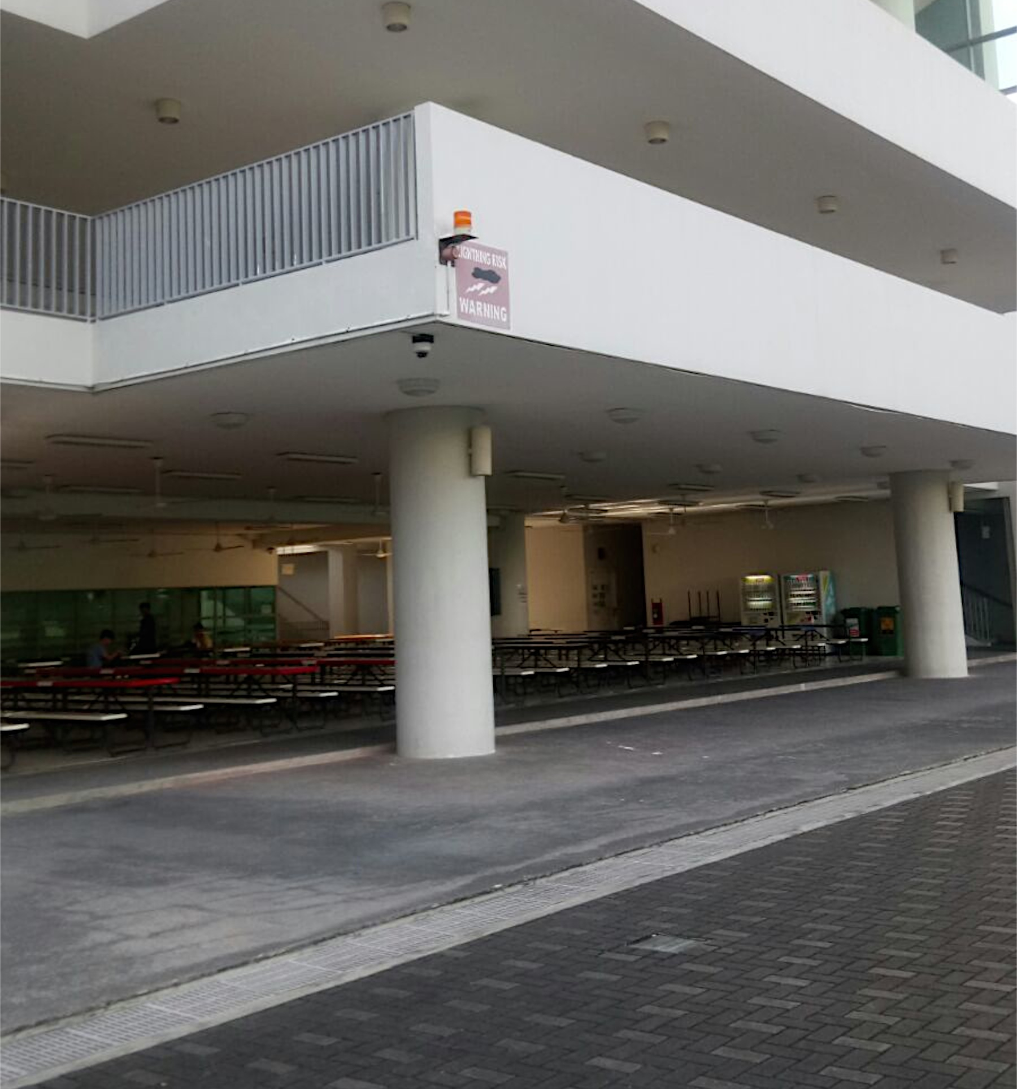
Placement of UV Alert

Slide 45
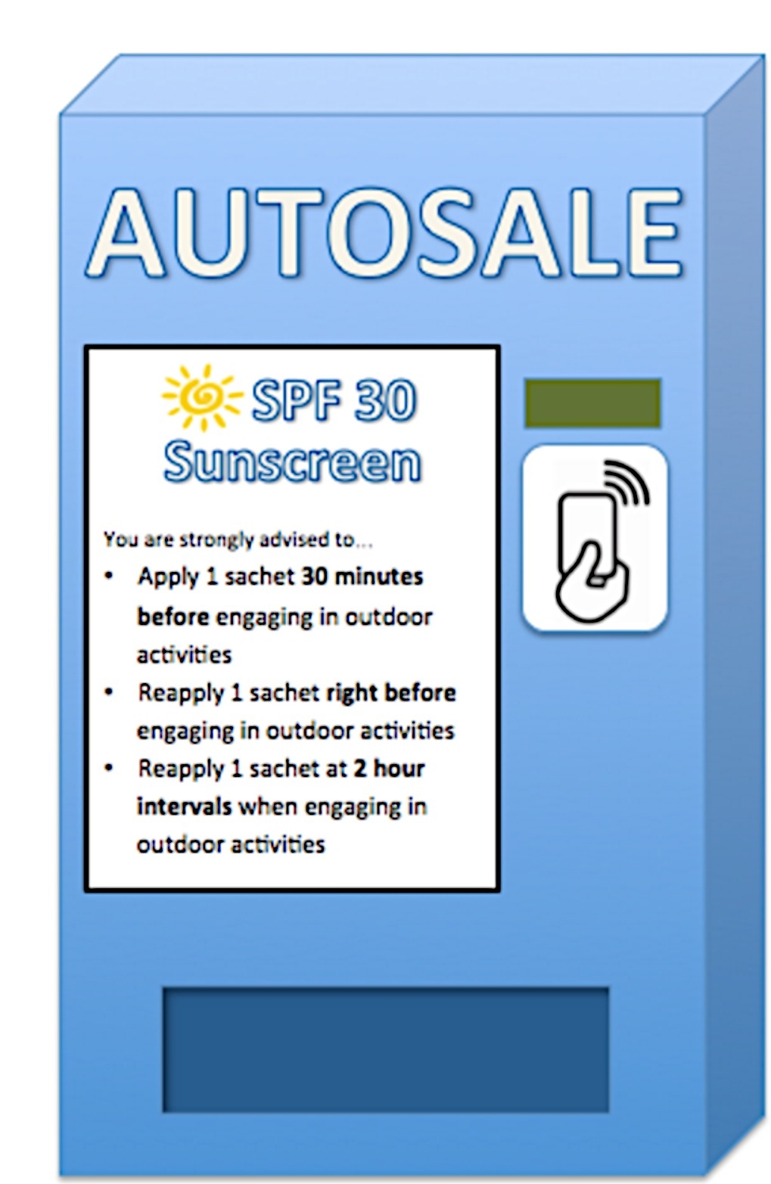

Sunscreen Vending Machine
Sells one-time use sunscreen sachets
CEPAS Card Reader
50 cm
Advices on sunscreen application
20 cm

Slide 46
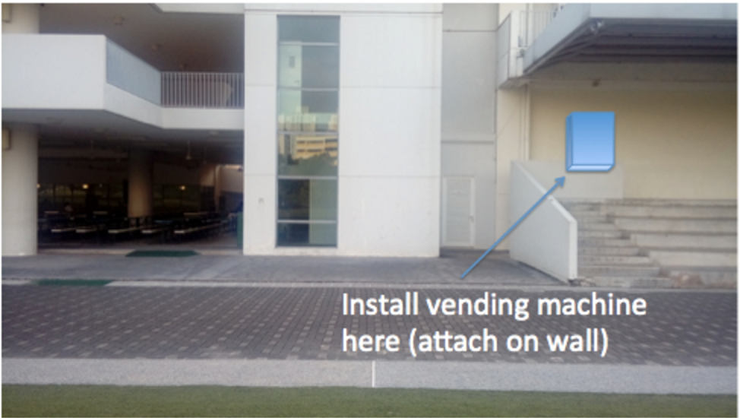
Sunscreen Vending Machine

Slide 47

Sunscreen Vending Machine
First two months
For the rest of the time
Free sunscreen sachets
For those who forget to bring
Sunscreen sachets at 20 cents each

Slide 48
Evaluation & Conclusion

Slide 49
Project Strength
Synergy
Eradicate apathetic nature
Create suitable environment
`
Open minds

Slide 50

Project Limitation
High Costs Incurred
Provision of free sunscreen
Installation of vending machines
Installation of UV alerts

Slide 51
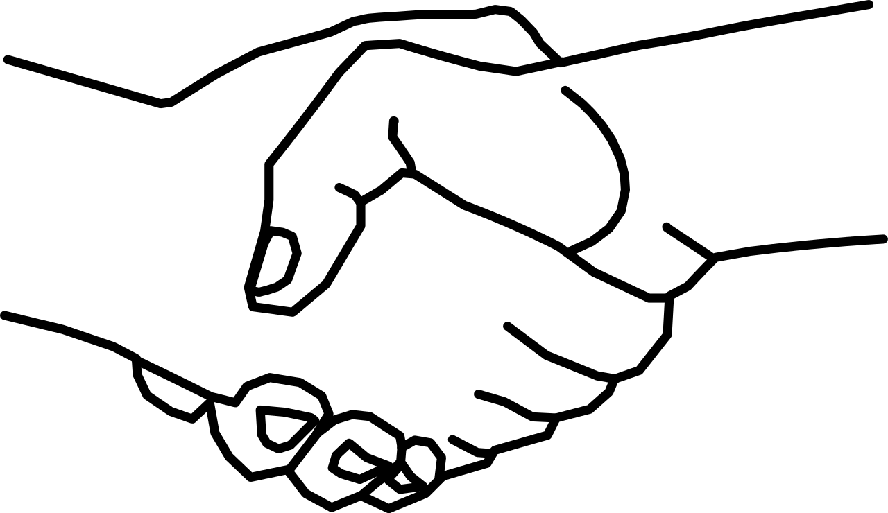
Overcoming the Limitation
Partnerships & Sponsorships

Slide 52
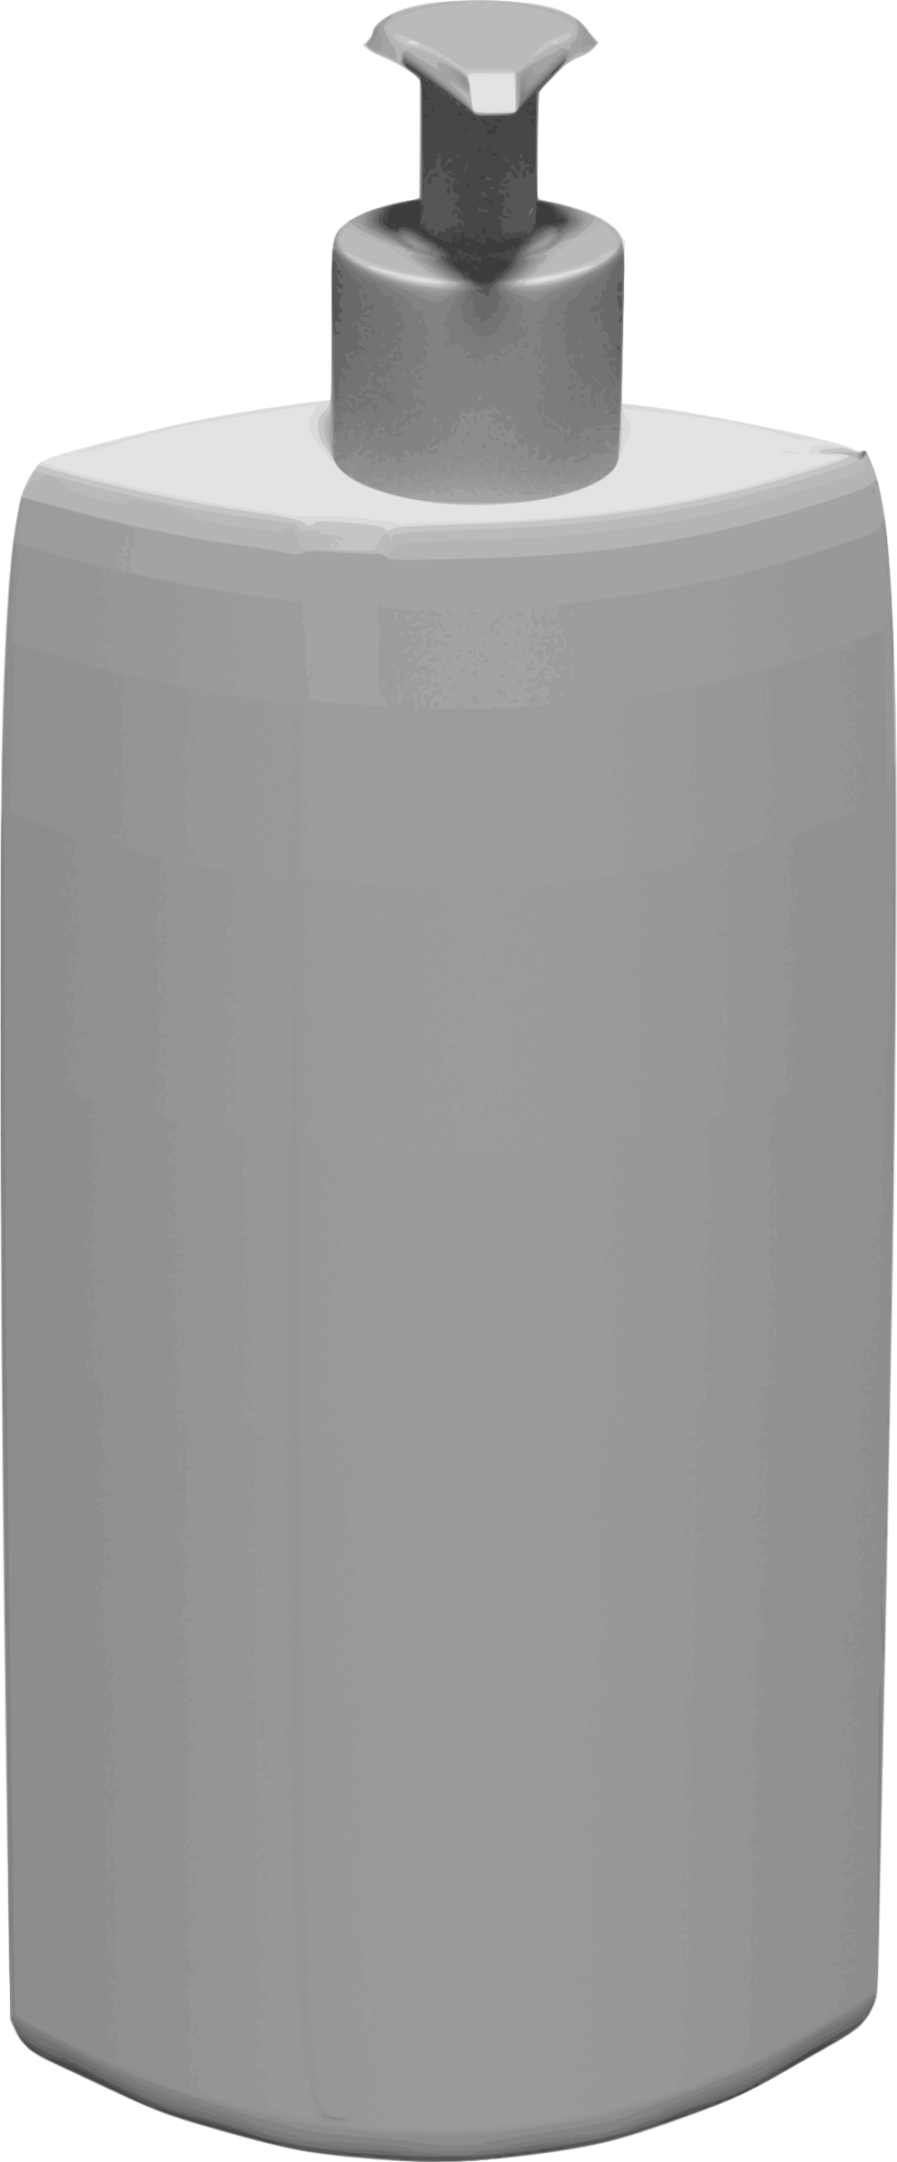

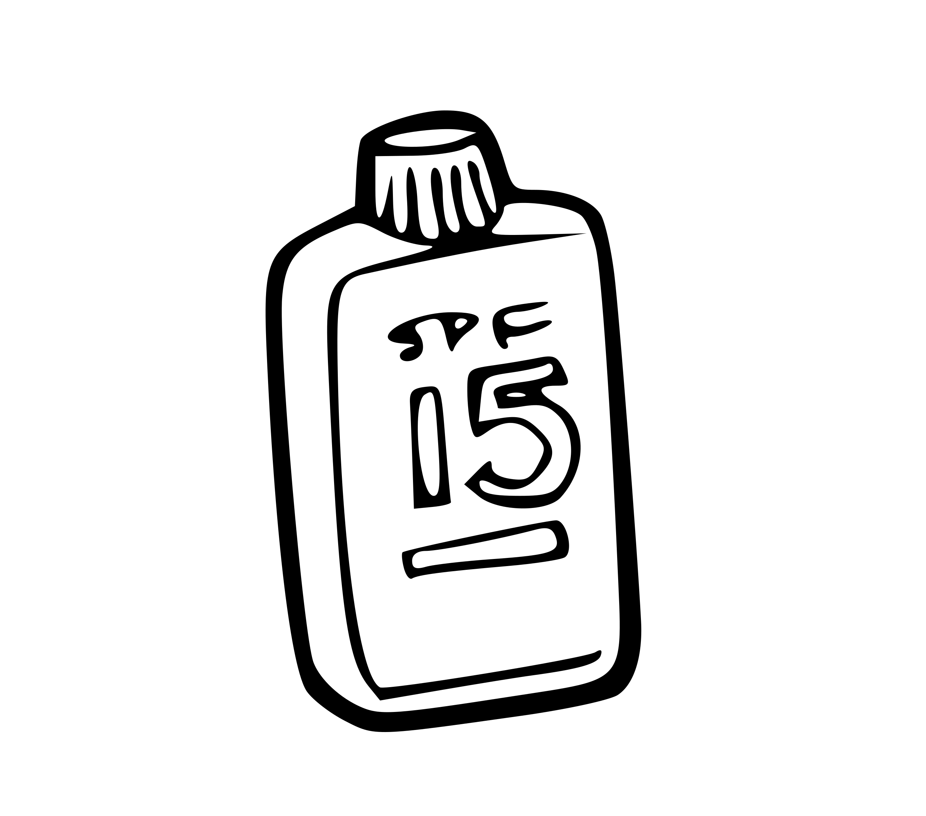

Overcoming the Limitation
National Environmental Agency (NEA)
Sunscreen Companies

Slide 53
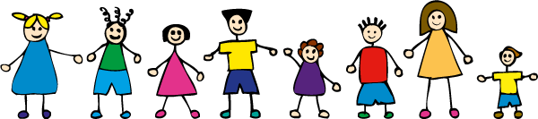
Possible Project Adaptations
Secondary school students
Primary school students

Slide 54
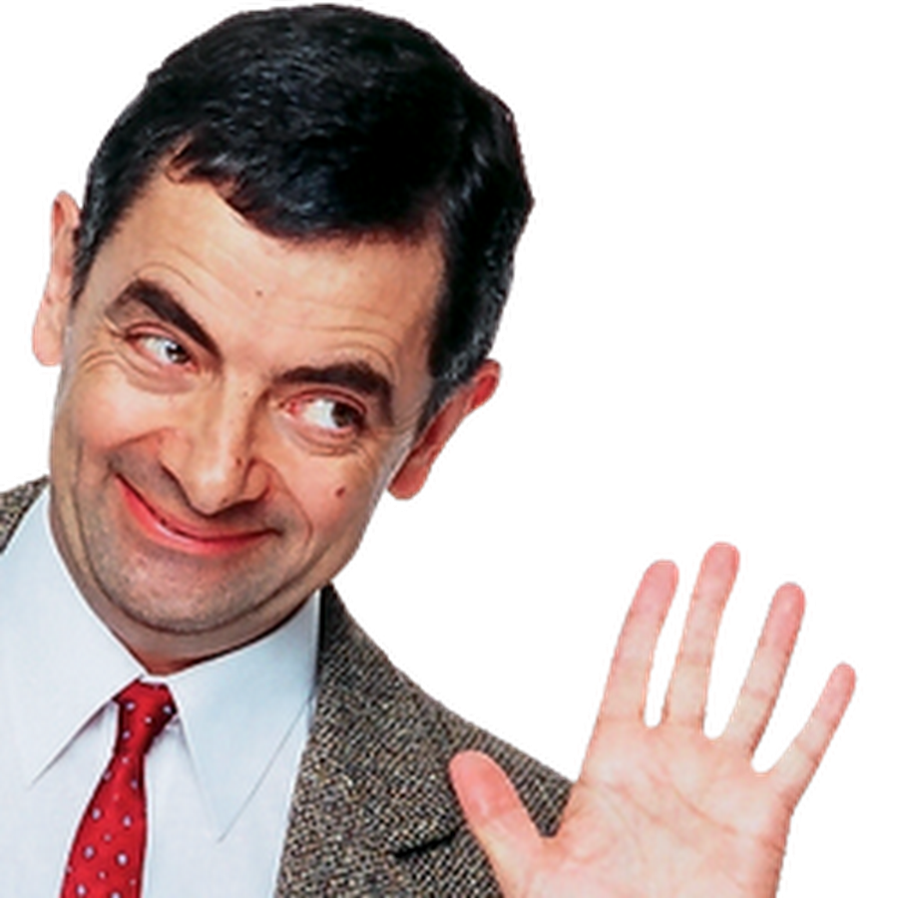
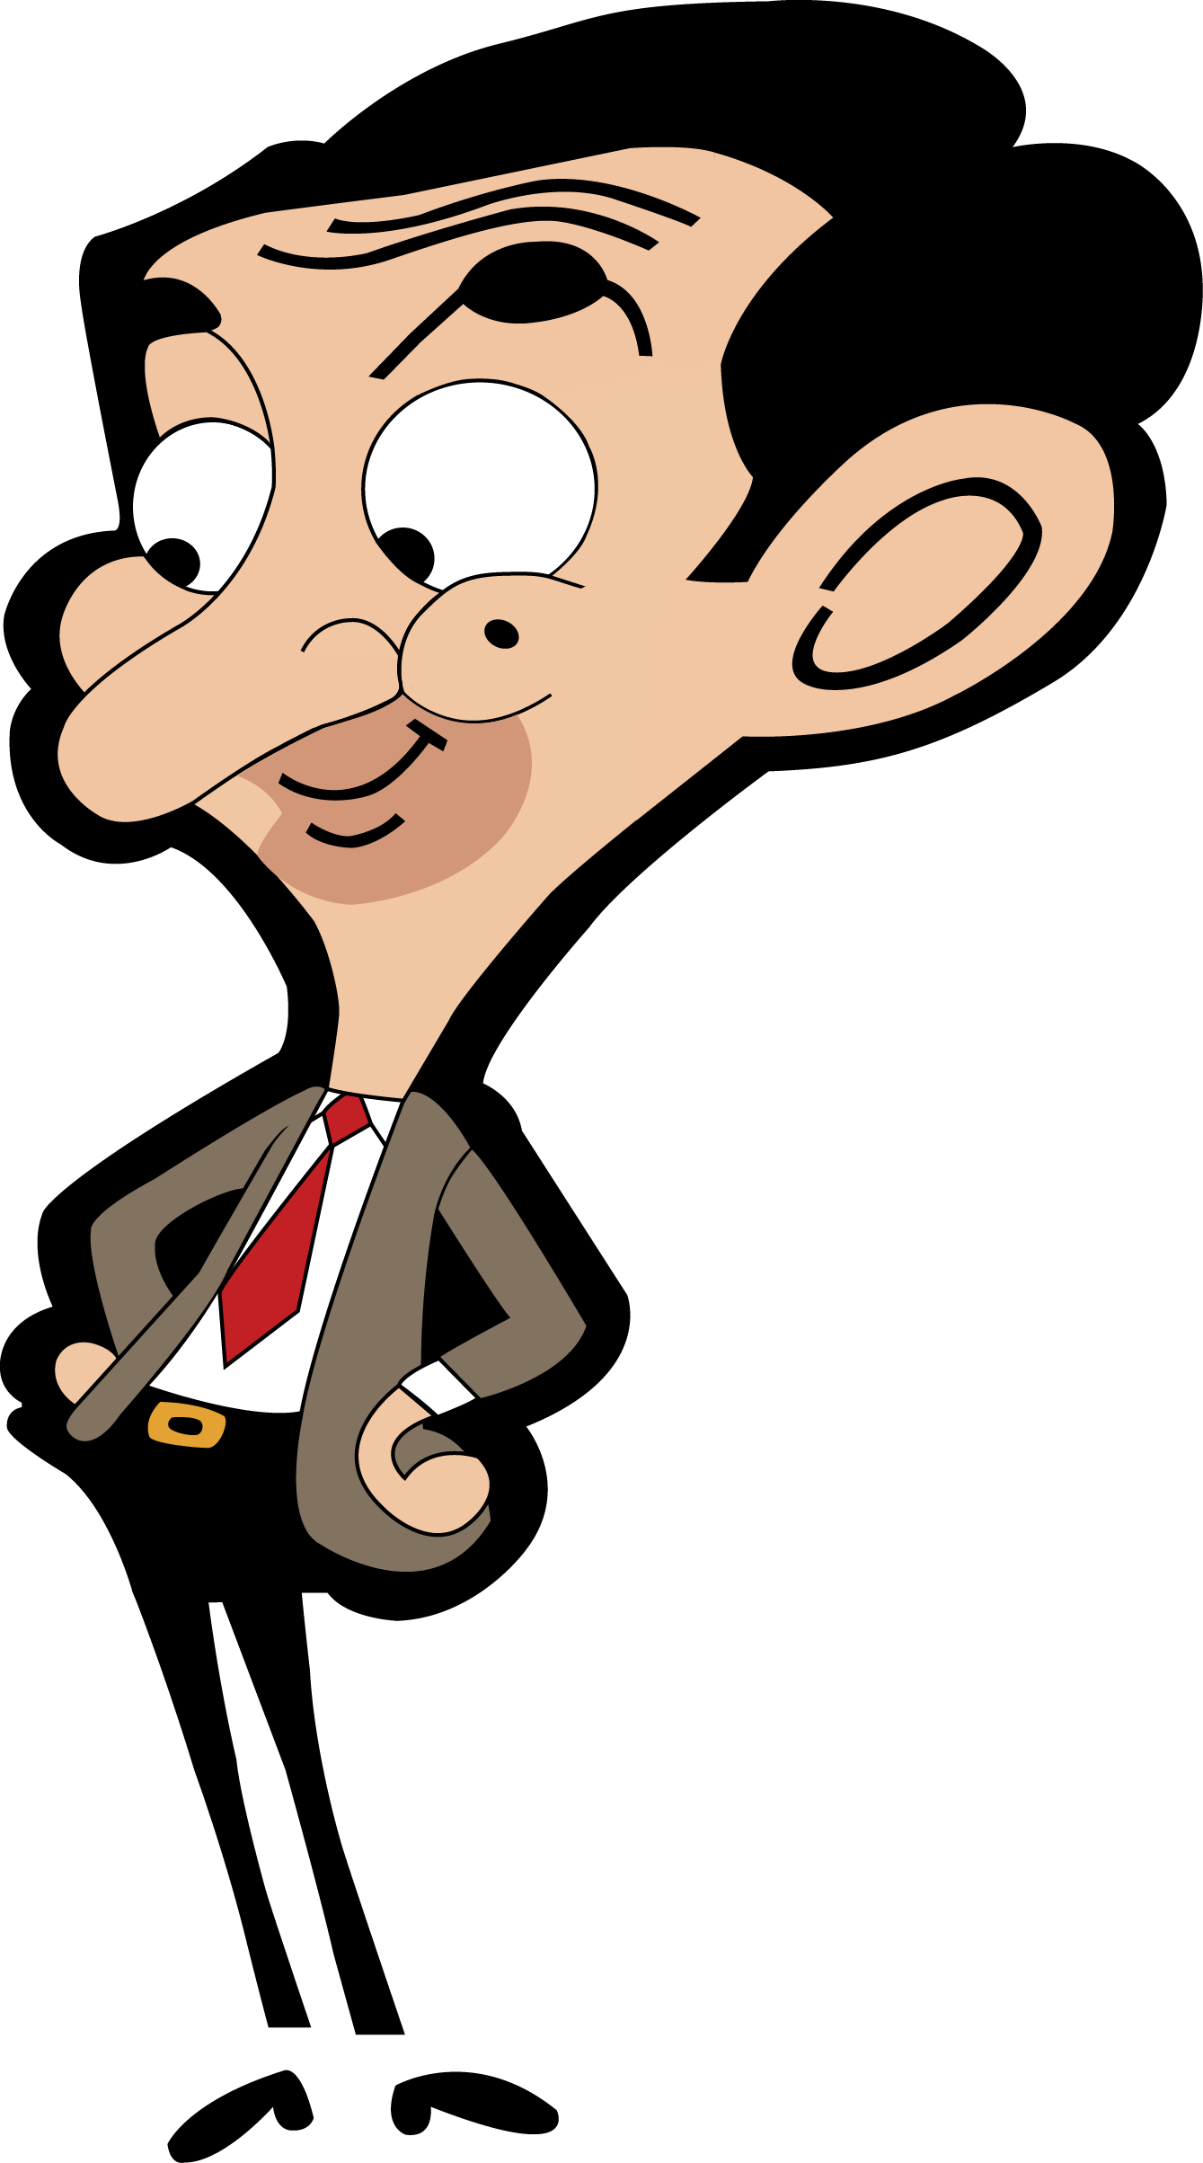
Possible Project Adaptations
Live action series
Animated Series

Slide 55
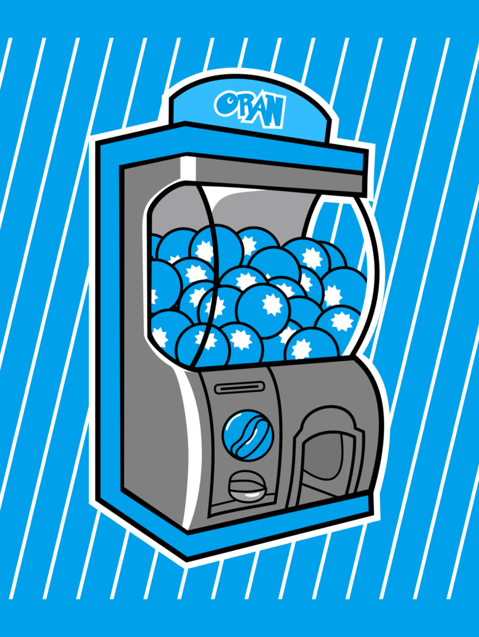
Possible Project Adaptations
Unpredictable design of sunscreen sachets
Appeal to children’s curiosity
Use of Gashapon machines

Slide 56
Thank You

